Slide 1
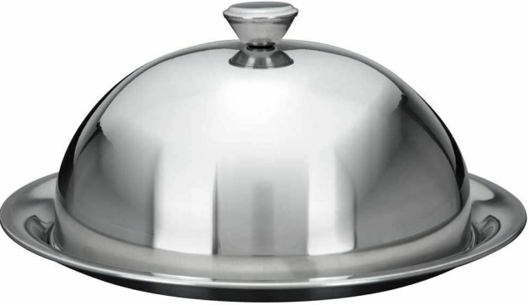
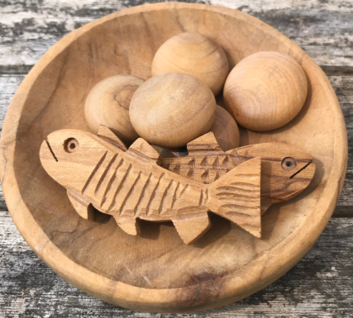
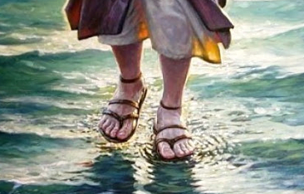
A Guilty Conscience, A Mighty Feast, A Miraculous Walk
Matthew 14

Slide 2
Matt 14:1-12 Herod’s Guilty Conscience
Matt 10 – disciples sent out on mission trip
Matt 11-13 – Jesus departed to teach
Now they have returned…
Luke 9:6-10 short overview

Slide 3
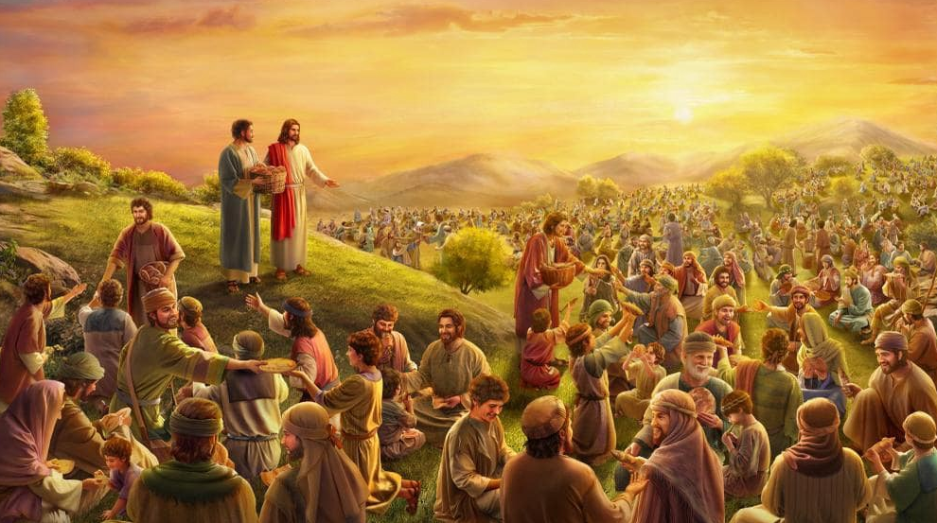
Matt 14:13-21 Feeding the Five Thousand
Mk 6:34 “moved with compassion because they were as sheep not having a shepherd”

Slide 4
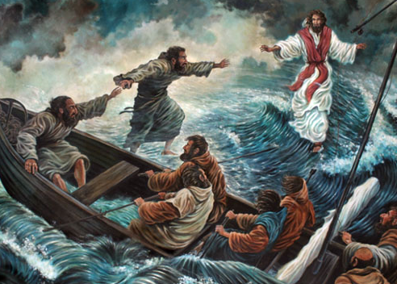
Matt 14:22-36 Walking on Water
14:28 Peter “Lord, if it is You, command me to come to You on the water”

Slide 5
Lessons
Awakened conscience – demands response, or heart hardens
Sometimes He calms the storm, sometimes calms the disciple
God delights to use but is not limited by our meagre resources
Empowered by faith, Peter walked on water too!
God not only wants to use “your stuff” but also “you” by faith

